Slide 1

Stroke Prediction
Josh Wang
04/20/2022

Slide 2

Background
A stroke occurs when the blood flow to the brain is blocked. It is the 5th cause of death and a leading cause of disability in the United States.
A stroke is an emergency situation, and it is important to be able to predict the onset of stroke.

Slide 3
The Data (from Kaggle)
features
target
age
gender
blood glucose
smoking status
heart disease
etc.
stroke (Y/N)

Slide 4
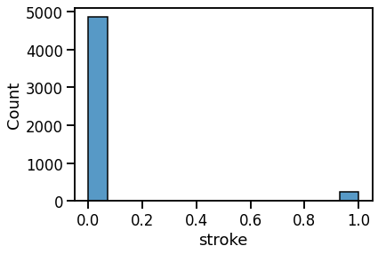
The Data – Class Imbalance
Data heavily skewed towards negative:
{0: 95%, 1: 5%}

Slide 5







Methodology
Data
Preprocessing
Cleaning
One hot encoding
Scaling
Feature Interaction
Under/oversampling
Modeling
RandomizedSearchCV
GridSearchCV
Deployment
from Kaggle
Missing data imputation

Slide 6
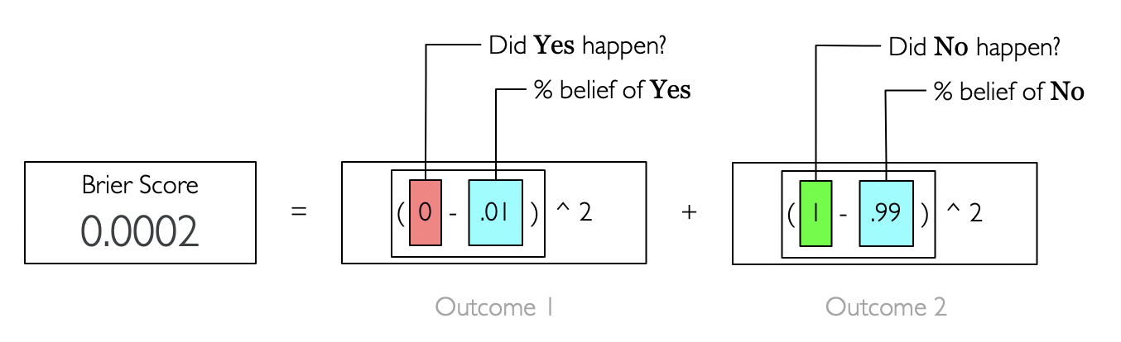
Evaluation Metric – Brier Skill Score
Brier Score is the sum of the squares of the residuals. (similar to Mean Squared Error)
Measures the accuracy of probabilistic predictions (lower is better):
Brier Skill Score (BSS) = 1 – BS/BS^{ref}
(higher is better)
BSS>0, model better than baseline
BSS=0, model has no skill
BSS<0, model worse than baseline

Slide 7
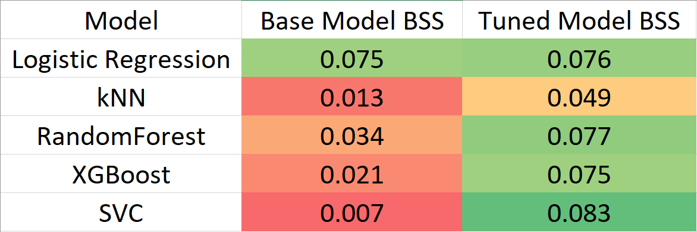
Results
Cross-validation scores (higher is better):
Probabilistic outputs were calibrated with Platt Scaling when necessary.
SVC wins. The BSS of SVC on the holdout data is 0.113

Slide 8
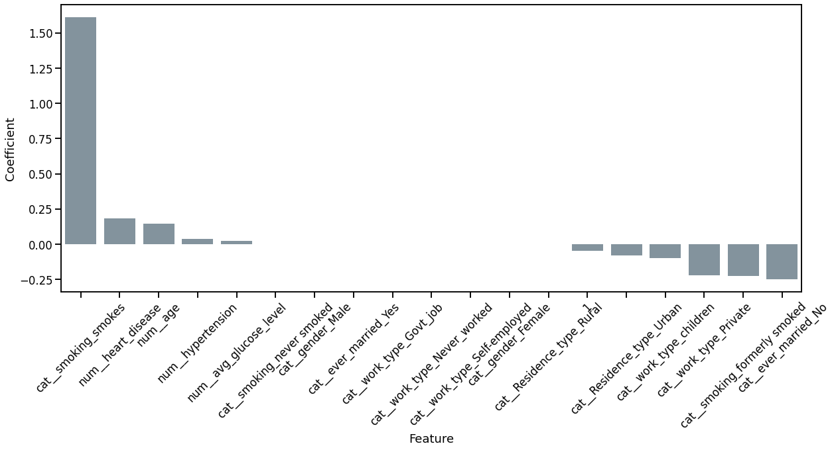
Results
Feature coefficients from Logistic Regression:

Slide 9

Product Deployment:
A Web App to Predict Stroke Onset
(powered by Streamlit)

Slide 11

Thank you
The code for this project can be found here:
https://github.com/JoshJingtianWang/Stroke_Prediction

